Slide 1
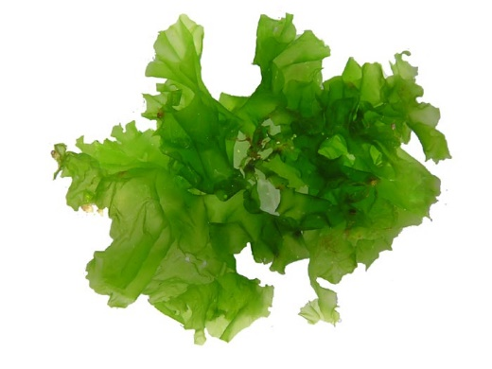
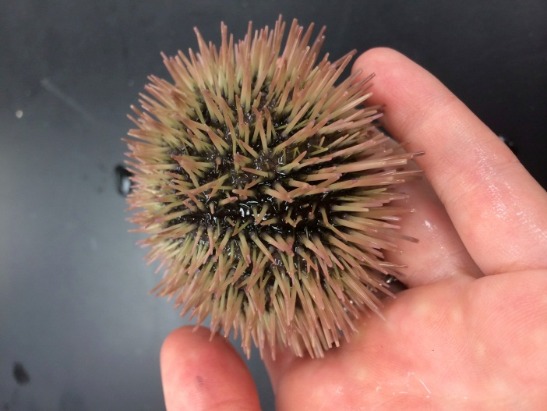
Bioremediation of Strontium and Copper in water by Algae and Sea Urchins
Group: 1-34
Sun Yudong 4S120
Dominique Huynh AOS
Zheng Yu Bo 4S127
Sabrina Kim AOS
protistaproject.weebly.com

Slide 2
Content
Introduction
Rationale & Objectives
Materials and Methods
Materials and Apparatus
Methodology
Variables
Results and Discussions

Slide 3
Introduction
Heavy metal pollution
Rapid Industrialization
Aquatic Environment
Current remediation techniques are expensive
Quickly Absorbed
Extremely Toxic to aquatic animals
(Bishnoi, Anju, & Garima, 2004)
Notes:
Heavy metal pollution is a serious problem that the world is facing today, with rapid industrialization
A remarkable increase in the use of heavy metals over the past few decades has inevitably resulted in an increased flux of metallic substances in the aquatic environment (Bishnoi, Anju, & Garima, 2004)
This poses a serious threat to the aquatic organisms’ health as heavy metals are highly toxic, and is quickly absorbed into the bodies of the organisms

Slide 4
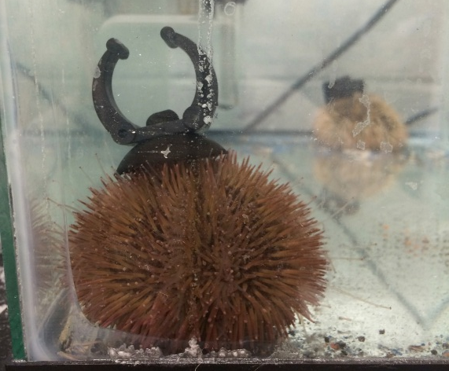
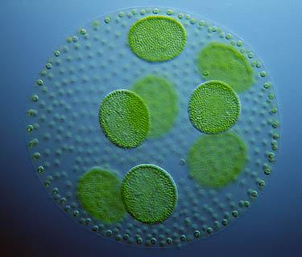
Introduction
Algae (Ulva)
Sea Urchins (Lytechinus variegatus)
Large group of photoautotrophic organisms
Can survive in various kinds of conditions and are extremely easy to grow
Biotransform
Readily absorb heavy metals from water
Have CaCO₃ spines
www.microscopy-uk.org.uk

Slide 5
Biosorption
Physical adsorption
Absorption
Displacement Reaction
Notes:
In the process of physical adsorption, heavy metal ions accumulated on the cell wall of the algae, which contains heteropolysaccharides that offer carboxyl and sulfate groups to accommodate these heavy metal ions.
However, since heavy metals such as copper are essential micronutrients and the Mayaca Algae has been found to take in heavy metal ions and absorb it, we believe a process of absorption also exist in the process of bioremediation of these heavy metal ions

Slide 6
Rationale
Ulva
Past Research
Algae: Promising bioremediators
Notes:
Since the Mayaca Algae has been known to be able to bioremediate heavy metal ions, we believe that the same can be achieved with green algae, Chlorophyta.
Also, research has shown that 2 divisions of chlorophyta has demonstrated bioremediation properties. The marine algae Spirogyra Sp. is able to remove mercury and cadmium from water, while Tetraselmis is able to remove cadmium. We speculate that the same can be achieved with Ulva. Hence, we will be testing the effectiveness and efficiency of Ulva in bioremediating heavy metal ions.

Slide 7
Rationale
For this project, we will be working on:
Cu²⁺
Sr²⁺
Notes:
PROOF OF CONCEPT

Slide 8
Rationale
Acceptable human threshold: 13.74ppm (US EPA, n.d.)
Nuclear disasters: 960ppm (Neal Blossom, n.d.)
Acceptable human threshold: 1.3 ppm (US EPA, n.d.)
Ocean: 0.00025 ppm in water and up to 100 ppm in sediments (Neal Blossom, n.d.)
Sr²⁺
Cu²⁺
Notes:
Strontium is released after a nuclear disaster
The concentrations found were up to 85 Bq·m⁻³ for ⁹⁰Sr and 265 Bq·m⁻³ for ⁸⁹Sr after Fukushima Daiichi incident (Casacuberta et al., 2013)

Slide 9
Objectives
A study of the effect of biosorption of heavy metals ions using live and dead algae as well as dead sea urchins shells will be conducted.
A comparison between dead and live algae
An investigation of whether dead urchins are able to take up Cu²⁺ and Sr²⁺
The quantitative measurement of biosorption will be done through biosorption capacity and biosorption efficiency

Slide 10

Biosorption Capacity
$$q=\frac{v(Ci – C)}{m}$$
Where
q = Biosorption Capacity (mg g⁻¹)
v = Volume of solution (l)
C_{i} = Initial concentration of the solution (mg l⁻¹)
C = Final concentration of the solution (mg l⁻¹)
m = Mass of the biomass (g)
(Fu et al, 2012)

Slide 11
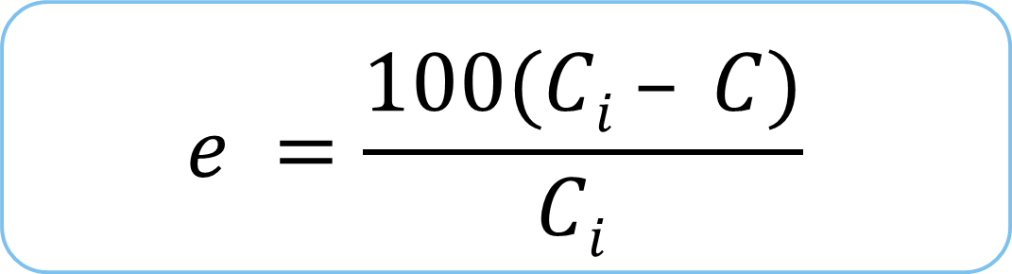
Biosorption Efficiency
$$e =\frac{100(Ci – C)}{Ci }$$
Where
e = Biosorption Efficiency (%)
C_{i} = Initial Concentration of the solution (mg l⁻¹)
C = Final Concentration of the solution (mg l⁻¹)
(Fu et al. 2012)

Slide 12
Hypothesis
Both algae and sea urchins are able to serve as heavy metal bioremediators
Live algae are better heavy metal bioremediators than dead algae
Notes:
Formatting re quired

Slide 13
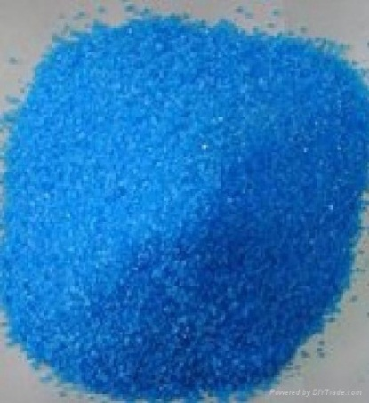
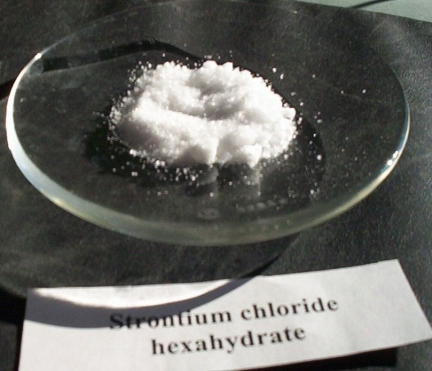
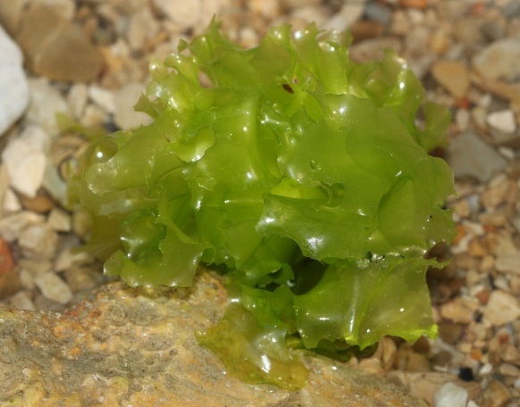
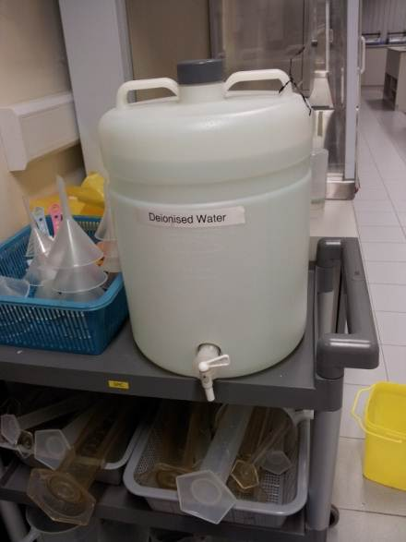
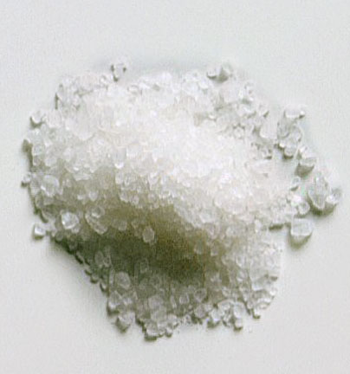
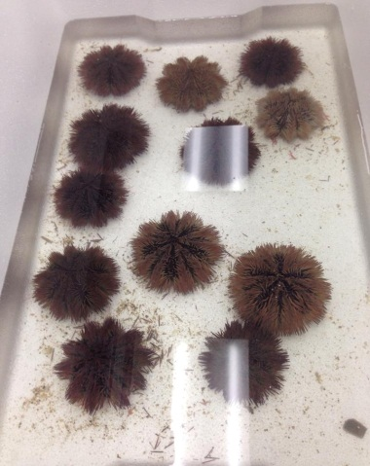
Materials
Copper(II) Sulfate pentahydrate
Strontium chloride hexahydrate
Ulva
Deionized water
Instant Ocean/ Sea Salt
Lytechinus variegatus
de.wikipedia.org
img.diytrade.com
en.wikipedia.org
www.topnews.in

Slide 14
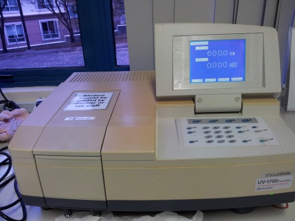
Apparatus
Spectrophotometer
Tanks
Pumps
Lights
Colorimeter
See-saw rocker
Air Conditioner
Conical flask
Orbital shaker
Centrifuge
Oven

Slide 15
Methodology
Beyond 25 ppm, sea urchin spines will start to drop and they die (Bielmyer, Brix, Capo, & Grosell, 2005)
Copper (Cu²⁺)
Minimum: DI Water
Upper Threshold: 25 ppm
Human Threshold: 1.3 ppm
Strontium (Sr²⁺)
Minimum: DI Water
Upper Threshold: 960 ppm
Human Threshold: 13.74 ppm

Slide 16
Variables
Independent variable
Initial Concentration of Heavy Metal Ion Solution
Controlled Variables
Mass of live Algae used
Volume of water
Dependent Variable
Concentration of Heavy Metal Ion Solution over time
Temperature of surroundings
Temperature of solution
Amount of light available
Time interval between each measurement
Type of heavy metal ions
Aliveness of organism

Slide 17
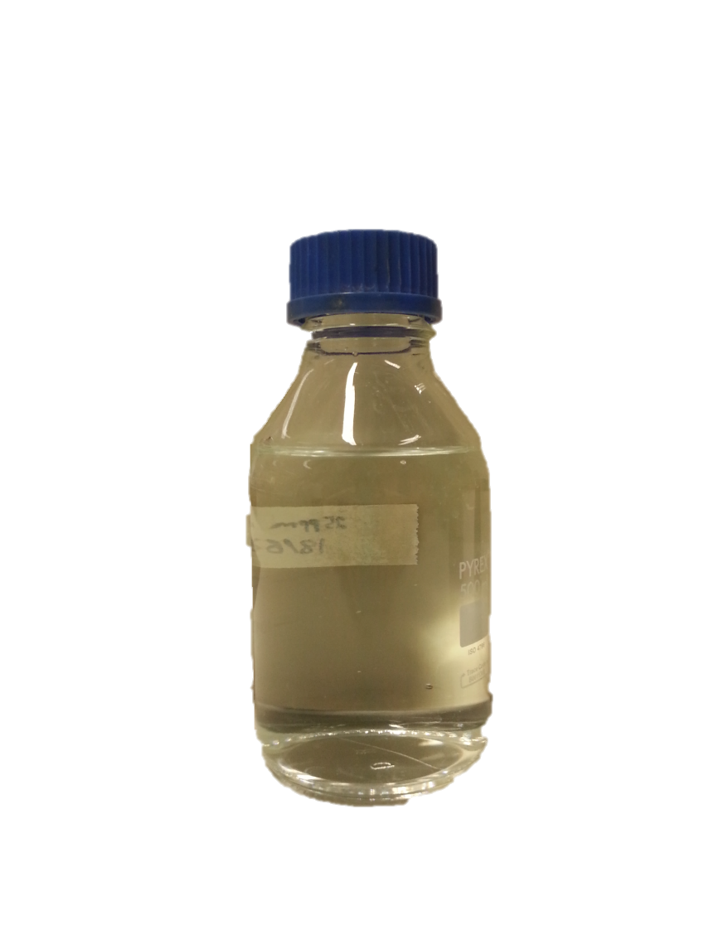
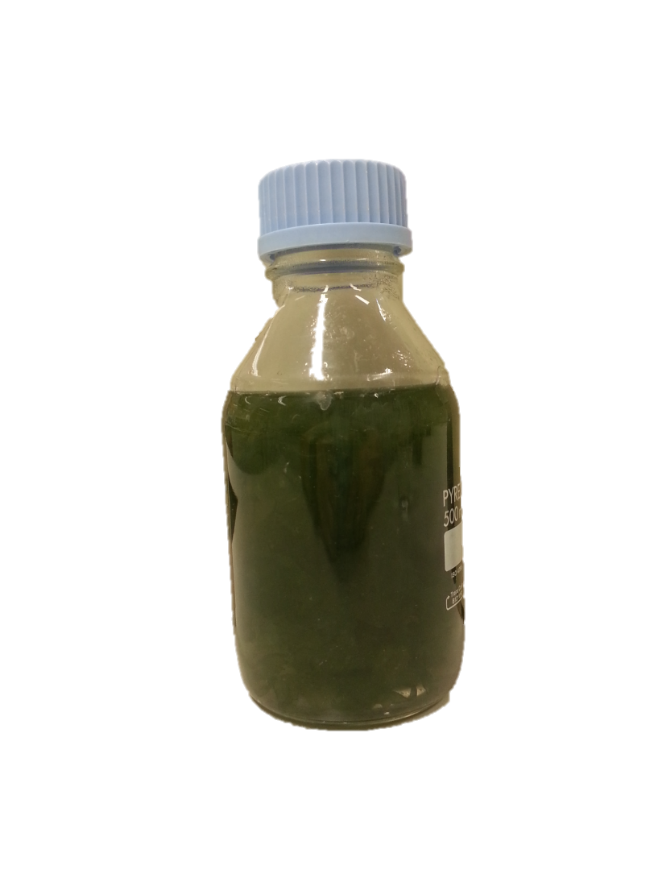
Methodology [Using Live Algae] Cu/Sr
Cu²⁺
Sr²⁺
× 5 Replicates
Test:
DI Water + CuSO₄/SrCl₂ + 5g Algae
Control:
DI Water + CuSO₄/SrCl₂
Samples were left on orbital shaker at 120 rpm

Slide 18
Methodology [Using Dead & Harvested Algae]
Live algae was dried until no further change in dry mass and crushed into a powder
Submerge algae in 1% Mass-to-volume ratio in concentrated heavy metal solution for 5 days.
Change in concentration of heavy metal ions are recorded over time
Centrifuge and test supernatant

Slide 19
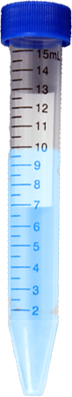
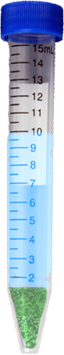
Methodology [Using Dead & Harvested Algae] Cu/Sr
Cu²⁺
Sr²⁺
× 5 Replicates
Test:
DI Water + CuSO₄/SrCl₂ + 0.1g Algae
Control:
DI Water + CuSO₄/SrCl₂
Samples were left on seesaw rocker at 30 rpm

Slide 20
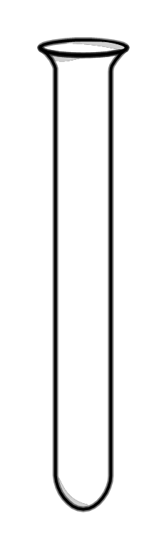
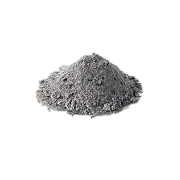
Methodology [Using Dead Urchin Shells]
Controls
Human Threshold
Maximum Threshold
Deionized water
Deionized water
Deionized water
Cu²⁺ : 1.3 ppm
Sr²⁺ : 13.74 ppm
Cu²⁺ : 25 ppm
Sr²⁺ : 960 ppm

Slide 21
Methodology
Dead Sample will be centrifuged at 9500 RPM for 10 mins
Colorimeter will be used to test amount of Cu²⁺ in solution
Spectrophotometer will be used to test amount of Sr²⁺ in solution with Xylenol Orange at 570 nm after dilution
Comparison:
Initial Cu²⁺/Sr²⁺ ion concentration
Final Cu²⁺/Sr²⁺ ion concentration
Final concentration of Cu²⁺/Sr²⁺ in algae
This was repeated many times, and measurement was taken over a period of 5 days
Biosorption Capacity Biosorption Efficiency

Slide 22
Methodology [Comparison of living/dead algae]
Results from dead algae tests
Comparison
Results from live algae tests
Through the comparison, we can find out:
The mechanism of removal of heavy metal ions by algae
Whether live algae or dead algae is a better bioremediator

Slide 23
Methodology [Comparison of urchin shells in different concentrations]
Results from human threshold tests
Comparison
Results from maximum threshold tests
Through the comparison, we can find out:
The maximum amount of heavy metal ions that can be taken up by urchin shells
How efficient are urchin shells in taking up the heavy metal ions

Slide 24
Results and Discussions

Slide 25
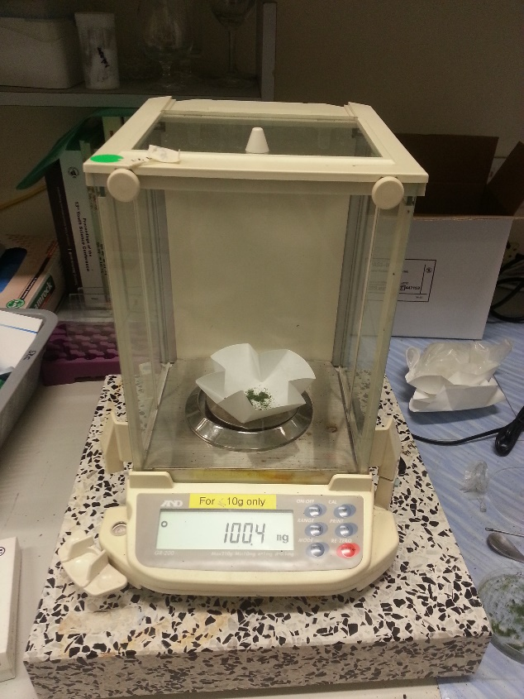
Strontium
Xylenol Orange was too sensitive to changes in pH, temperature and microconcentrations of strontium in both algae and urchin trials (Majeed, Asma, Firdos, Nasim, and Athar, 1997
Inconsistent results
Hence we are still working on strontium measurements

Slide 26
Results [Algae]
The results were compiled in Excel
Statistical Tests were run
Biosorption Capacity and Biosorption Efficiency were calculated
We took 30 readings for live and dead algae in the different concentrations of Cu²⁺ and Sr²⁺.
We took 8 readings for dead urchin shells in the different concentrations of Cu²⁺ and Sr²⁺.

Slide 27
Graphs [Algae Cu²⁺ Absorbed]
P > 0.05
P < 0.05
Notes:
Cu²⁺ Absorbed in 1.3 ppm Cu²⁺/ppm
Surface, assimilated into tissue for 25
1.3 ppm has no explanation? More cellulose call wall (because dry mass)
Dry mass increases surface area at low conc is better. But at high conc, the additional mechanism plays a more significant role and uptakes more heavy metal ions

Slide 28
Graphs [Algae Biosorption Efficiency]
P > 0.05
P < 0.05
Notes:
Biosorption Efficiency for 1.3 ppm Cu²⁺ (%)

Slide 29
Graphs [Algae Biosorption Capacity]
P > 0.05
P < 0.05
Notes:
Biosorption Capacity for 1.3 ppm Cu²⁺ (mg/g)

Slide 30
Graphs [Urchins Cu²⁺]

Slide 31
Statistical Analysis [Algae]
In order to ensure that the difference in results between the live and dead are statistically significant, a statistical t-test was carried out.
P-value for 1.3ppm:
0.342
P-value for 25ppm:
0.002
Not statistically significant
Statistically significant

Slide 32
Statistical Analysis [Urchins]
In order to ensure that the difference in results obtained are statistically significant, a mann-whitney U-Test was carried out.
P-value for 1.3ppm:
0.0074
P-value for 25ppm:
0.0050
Statistically significant
Statistically significant

Slide 33
Drawing Conclusions
live algae are better bioremediators than dead algae, especially at higher concentrations
This can be seen from the difference in the bioremediation efficiencies of the two types of algae.
Our statistical test further affirms our conclusion by showing that live algae are significantly better bioremediators than dead algae.
Dead has increased surface area for biosorption at low concentration. But at high concentrations, the additional mechanism plays a more significant role and uptakes more heavy metal ions.
Urchins take up more copper at higher concentrations due to greater effective collisions between shells and ions

Slide 34
Applications
Through the use of live organisms instead of chemicals, the following can be achieved at low costs and without huge impacts to the habitat:
Remediation in nuclear polluted waters containing Strontium
Remediation of polluted wastewaters due to improper water treatment processes

Slide 35
Applications
Copper trials affirmed the bioremediation abilities of these organisms. For commercial application of algal technology for optimal metal removal from wastewater, the emphasis needs to be on:
Selection of strain with high metal sorption capacity
Adequate understanding of sorption mechanisms
Economic feasibility
By using sea urchins with algae, we are using organisms of the same habitat which are progressive in the food chain, thereby increasing biosorption through bioaccumulation

Slide 36

Future Work
We shall continue to run our strontium tests using other methods to measure the final concentration (e.g. titration)
Extend to other species of algae and organisms
Using microalgae to increase overall surface area for absorption
Using other plant materials or crustaceans
Building a bioreactor to remove heavy metal ions from the water at lower cost
horsesforsources.com

Slide 37
References
Bielmyer, G. K., Brix, K. V., Capo, T. R., & Grosell, M. (2005). The effects of metals on embryo-larval and adult life stages of the sea urchin, Diadema antillarum. Aquatic toxicology (Amsterdam, Netherlands), 74(3), 254–263. doi:10.1016/j.aquatox.2005.05.016
Bioconcentration factors (BCFs) for aquatic organisms. (n.d.). Retrieved from http://uwrl.usu.edu/www/doucette/6730/CEE%205730%20BCF%20lec%209-1.pdf
Bishnoi, N. R., Anju, P., & Garima. (2004). Biosorption of copper from aqueous solution using algal biomass. Journal of Scientific & Industrial Research, 63(October 2004), 813–816.
Bunghez, I.-R., Ion, R.-M., Dumitriu, I., & Fierascu, R.-C. (2010). Heavy Metal Ions Depollution by Marine Natural Products. Journal of Science and Arts, 1(12), 73–78.
Casacuberta, N., Masque, P., Garcia-Orellana, J., Garcia-Tenorio, R., & Buesseler, K. O. (2013). 90Sr and 89Sr in seawater oﬀ Japan as a consequence of the Fukushima Dai-ichi nuclear accident. Biogeosciences, 10, 3649–3659. doi:10.5194/bg-10-3649-2013
Fu, Y. Q., Li, S., Zhu, H. Y., Jiang, R., & Yin, L. F. (2012). Biosorption of copper from aqueous solutions by mycelial pellets of rhizopus oryzae. African Journal of Biotechnology, 11(6), 1403–1411.
Kumar, J. I. N., & Oommen, C. (2010). Removal of heavy metals by biosorption using freshwater alga Spirogyra hyalina. Journal of Environmental Biology, (January 2012), 27 – 31.
Large-Scale Production of Biofuels Made From Algae Poses Sustainability Concerns; Further Innovations Needed to Reach Full Potential. (2012, October 24). National-Academies.org | Newsroom. Retrieved November 9, 2013, from http://www8.nationalacademies.org/onpinews/newsitem.aspx?RecordID=13437
Mehta, S. K., & Gaur, J. P. (2005). Use of algae for removing heavy metal ions from wastewater: progress and prospects. Critical reviews in biotechnology, 25(3), 113–152. doi:10.1080/07388550500248571
Neal Blossom. (n.d.). Copper in the Ocean Environment.
Pérez-Rama, M., Abalde Alonso, J., Herrero López, C., & Torres Vaamonde, E. (2002). Cadmium removal by living cells of the marine microalga Tetraselmis suecica. Bioresource Technology, 84(3), 265–270. doi:10.1016/S0960-8524(02)00045-7
Suresh, B., & Ravishankar, G. A. (2004). Phytoremediation--a novel and promising approach for environmental clean-up. Critical reviews in biotechnology, 24(2-3), 97–124. doi:10.1080/07388550490493627
US EPA, O. (n.d.). Basic Information about Copper in Drinking Water. Retrieved November 15, 2013, from http://water.epa.gov/drink/contaminants/basicinformation/copper.cfm

Slide 38
Any Questions?

Slide 39
Image References
Cover Photo: Ulva http://protistaproject.weebly.com/uploads/1/2/2/7/12279313/516921448_orig.jpg
http://www.horsesforsources.com/wp-content/uploads/2011/05/The-present-of-work.jpg
http://rarecrossfit.com/wp-content/uploads/2013/07/limitations.jpg

Slide 40
Rationale
For this project, we will be working on:
Cu²⁺
Sr²⁺
Notes:
PROOF OF CONCEPT

Slide 41
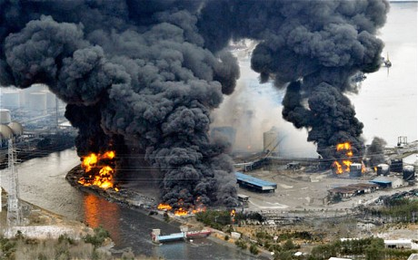
Problem
The heavy metals in the oceans are increasing
Pollution
Nuclear disasters
Current methods of remediation are expensive
Thus emphasizing the need for a natural method of bioremediation
https://encrypted-tbn3.gstatic.com/images?q=tbn:ANd9GcT-xWtnfiO7gtsPJabfqhtJ122tRggWrGmvevgBS1zHPSeEBL41
Notes:
Explain how the picture shows a factory facility burning after the nuclear power plant accident in Japan

Slide 42
Rationale
Cu²⁺ finds its way to water bodies through wastewater from Cu wire mills, coal burning industries, electroplating, tanning, smelting and refining, insecticides, fungicides, and iron and steel producing industries. (Bishnoi, Anju, & Garima, 2004)
Notes:
Many method are expensive ->non-optimal
Strontium triangle

Slide 43
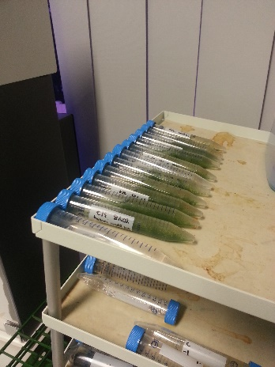
Methodology [Using Dead & Harvested Algae/Urchins]
Colorimeter will be used to test amount of Cu²⁺ in solution
Spectrophotometer will be used to test amount of Sr²⁺ in solution
Comparison:
Initial Cu²⁺/Sr²⁺ concentration
Final Cu²⁺/Sr²⁺ concentration
Final concentration of Cu²⁺/Sr²⁺ in dead algae
This was repeated many times
Biosorption Capacity Biosorption Efficiency

Slide 44
Graphs [Algae]
Notes:
Barely any difference for 1.3, but a greater difference for 25 ppm.

Slide 45
At low concentrations, there is not much of a difference. However, at higher concentrations, live algae is a better bioremediator
Notes:
Barely any difference for 1.3, but a greater difference for 25 ppm.

Slide 46
Dead

Slide 47
Overview of Experimental Design
Dead Urchin Shells & algae → Biosorption at different concentrations of HMI solutions
Compare the results of the quantitative measurement of biosorption using the formulae for biosorption capacity and biosorption efficiency

Slide 48
Graphs [Day 5 Readings]

Slide 49
Graphs
Here are the graph comparisons for live and dead algae in 1.3 ppm Cu²⁺ solution

Slide 50
Graphs
Here are the graph comparisons for live and dead algae in 1.3 ppm Cu²⁺ solution

Slide 51
Graphs
Here are the graph comparisons for live and dead algae in 25 ppm Cu²⁺ solution

Slide 52
Graphs
Here are the graph comparisons for live and dead algae in 25 ppm Cu²⁺ solution

Slide 53
Introduction
Algae are a large group of photoautotrophic organisms
They can survive in various kinds of conditions and are extremely easy to grow.
(“Large-Scale Production of Biofuels Made From Algae Poses Sustainability Concerns; Further Innovations Needed to Reach Full Potential,” 2012)
Hence, algae are a very accessible resource, and can be readily used for bioremediation.
www.microscopy-uk.org.uk

Slide 54
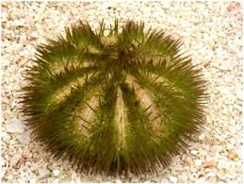
Introduction
Sea Urchins (Lytechinus variegatus)
Biotransform
Readily absorb heavy metals from water
Have CaCO₃ spines
http://www.sms.si.edu/irlspec/images/Lytech_varieg_1.jpg
Notes:
Expand on the research suggesting that it can bio-transform and readily absorb heavy metals

Slide 55
Biosorption
Physical adsorption
The process where the heavy metals are adsorbed into algae
Cell wall of green algae contains heteropolysaccharides, which offer carboxyl and sulfate groups for sequestration of heavy metal ions (Kumar & Oommen, 2010)
Absorption
Mayaca fluviatilis algae takes in heavy metal ions and absorbs it
Heavy metals such as Cu are essential micronutrients for algal metabolism (Bunghez, Ion, Dumitriu, & Fierascu, 2010)
Displacement Reaction
Cu²⁺ has a similar electronic configuration as the Ca2+ ions in sea urchin spines
Shells of sea urchins contain the mineral aragonite, which is able to uptake aqueous heavy metal ions via surface precipitation (Thirveni et al., n.d.)
Notes:
In the process of physical adsorption, heavy metal ions accumulated on the cell wall of the algae, which contains heteropolysaccharides that offer carboxyl and sulfate groups to accommodate these heavy metal ions.
However, since heavy metals such as copper are essential micronutrients and the Mayaca Algae has been found to take in heavy metal ions and absorb it, we believe a process of absorption also exist in the process of bioremediation of these heavy metal ions

Slide 56
Rationale
spirogyra sp. has been known to have the ability to accumulate heavy metals such as cadmium and mercury (Kumar & Oommen, 2010)
We believe that the same can be achieved with marine green algae under the division Chlorophyta
Research has shown that marine algae Tetraselmis is able to remove cadmium (Pérez-Rama, Abalde Alonso, Herrero López, & Torres Vaamonde, 2002)
We speculate that another marine algae Ulva will also be able to remove heavy metal ions
For this project, we will be investigating the effectiveness and efficiency of Ulva in absorbing heavy metal ions.
Notes:
Since the Mayaca Algae has been known to be able to bioremediate heavy metal ions, we believe that the same can be achieved with green algae, Chlorophyta.
Also, research has shown that 2 divisions of chlorophyta has demonstrated bioremediation properties. The marine algae Spirogyra Sp. is able to remove mercury and cadmium from water, while Tetraselmis is able to remove cadmium. We speculate that the same can be achieved with Ulva. Hence, we will be testing the effectiveness and efficiency of Ulva in bioremediating heavy metal ions.

Slide 57
Methodology [Main Experimental Timeline]
Using Live algae
Using Dead & Harvested algae

Slide 58
Overview of Experimental Design
Live Algae → Biosorption at different concentrations of HMI solutions
Dried Algal Tissue → Biosorption at different concentrations of HMI solutions
Compare the results of the quantitative measurement of biosorption using the formulae for biosorption capacity and biosorption efficiency

Slide 59
Methodology [Using Dead & Harvested Algae] Strontium
Sr²⁺
× 5 Replicates
Control:
DI Water + SrCl₂
Test:
DI Water + SrCl₂ + 0.1g Algae
Samples were left on seesaw rocker at 30 rpm

